Slide 1

Literature Review
In my literature review on the LC25000 dataset, I explored several publications focused on lung and colon cancer classification. I came across a variety of approaches, each offering unique techniques and insights, which helped me better understand how different methods can enhance the accuracy and effectiveness of tumor detection.

Slide 2
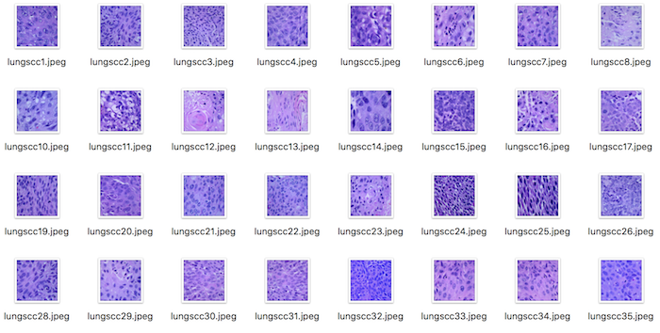
Lung and Colon Cancer Histopathological Image Dataset (LC25000)Histopathological Image Dataset (LC25000)
Authors : Andrew A. Borkowski, Marilyn M. Bui, L. Brannon Thomas, Catherine P. Wilson, Lauren A. DeLand, Stephen M. Mastorides
Link: https://arxiv.org/abs/1912.12142
Research question(s) / Goal:
Introduce a new dataset for lung and colon cancer histopathological images to facilitate research in computer-aided diagnosis.
Dataset:
LC25000 dataset containing 25,000 images of lung and colon tissues, categorized into five classes.
Methodology:
Dataset creation, image preprocessing, and data augmentation techniques.
Results & Limitations:
Describes the characteristics of the dataset, including image size, resolution, and class distribution.
Highlights the potential applications of the dataset for research in computer-aided diagnosis.
Huge dataset students cannot handle with their normal computers.

Slide 3
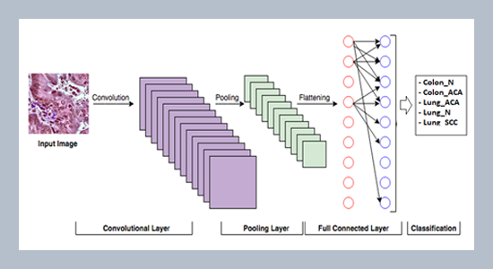
Deep Learning in Lung and Colon Cancer Classifications
Authors: Krishna Mridha, MD. Iftekhar Islam, Shamin Ashfaq, Masrur Ahsan Priyok, Dipayan Barua
Link: https://ieeexplore.ieee.org/document/10009311
Research Question(s) / Goal:
Deep learning, specifically convolutional neural networks (CNNs), can accurately classify lung and colon cancer images. The goal is to build a reliable model that can differentiate between cancerous and normal tissue, supporting early diagnosis and improving treatment outcomes.
Dataset:
The dataset used includes images of lung and colon tissues divided into classes:
- Lung: Normal (Lung N), Adenocarcinoma (Lung ACA), Squamous Cell Carcinoma (Lung SCC)
- Colon: Normal (Colon N), Adenocarcinoma (Colon ACA)
Methodology:
The researchers apply CNNs to classify the medical images. Key steps include:
1. Image Preprocessing: Resizing and normalization.
2. CNN Architecture: Multi-layer CNNs are used to extract image features.
3. Training and Validation: The dataset is split into training and validation sets, with CNNs trained to recognize features distinguishing normal and cancerous tissues.
4. Evaluation: Metrics such as accuracy, precision, recall, and F1-score are used for assessment.
Results & Limitations:
The CNN models demonstrate high accuracy (98.3) in classifying both lung and colon cancer images, showing the efficacy of deep learning in medical image analysis. The models help in automating cancer detection, potentially aiding medical professionals.
1. Data Generalization: The dataset might not represent all variations in tissue samples, limiting generalization.
2. Computational Requirements: CNNs demand significant computational resources, which could be a barrier in resource-constrained environments.

Slide 4
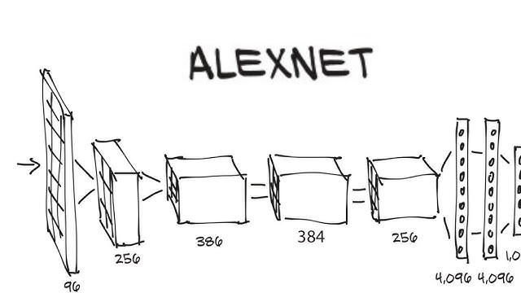
Malignancy Detection in Lung and Colon Histopathology Images Using Transfer Learning With Class Selective Image Processing
Link: https://ieeexplore.ieee.org/document/9709814
Authors: Shahid Mehmood, Taher M. Ghazal, Muhammad Adnan Khan, Muhammad Zubair, Muhammad Tahir Naseem, Tauqeer Faiz
Research Question(s) / Goal:
how transfer learning combined with class-selective image processing can enhance the accuracy of detecting malignancies in lung and colon histopathology images. The goal is to develop an efficient model for early cancer detection, improving classification accuracy for malignant and non-malignant tissues.
Dataset:
The dataset contains histopathology images of lung and colon tissues, labeled as malignant and non-malignant. These images are used to train and evaluate the model.
Methodology:
1. Preprocessing: Class-selective image processing techniques are applied to enhance relevant areas of the tissue samples.
2. Transfer Learning: Pre-trained models AlexNet are fine-tuned on the lung and colon image dataset.
3. Training and Evaluation: The dataset is split for training and testing, and metrics like accuracy, sensitivity, specificity, and F1-score are used to evaluate model performance.
Results & Limitations:
The model demonstrated high accuracy(98.4%) in detecting malignancies, with transfer learning significantly improving classification performance. The combination of transfer learning and class-selective image processing shows strong potential for clinical cancer diagnostics
1. Computational Demand: Fine-tuning pre-trained models requires significant computational resources.
2. Bias in Image Processing: Class-selective processing might introduce biases if not carefully tuned.

Slide 5
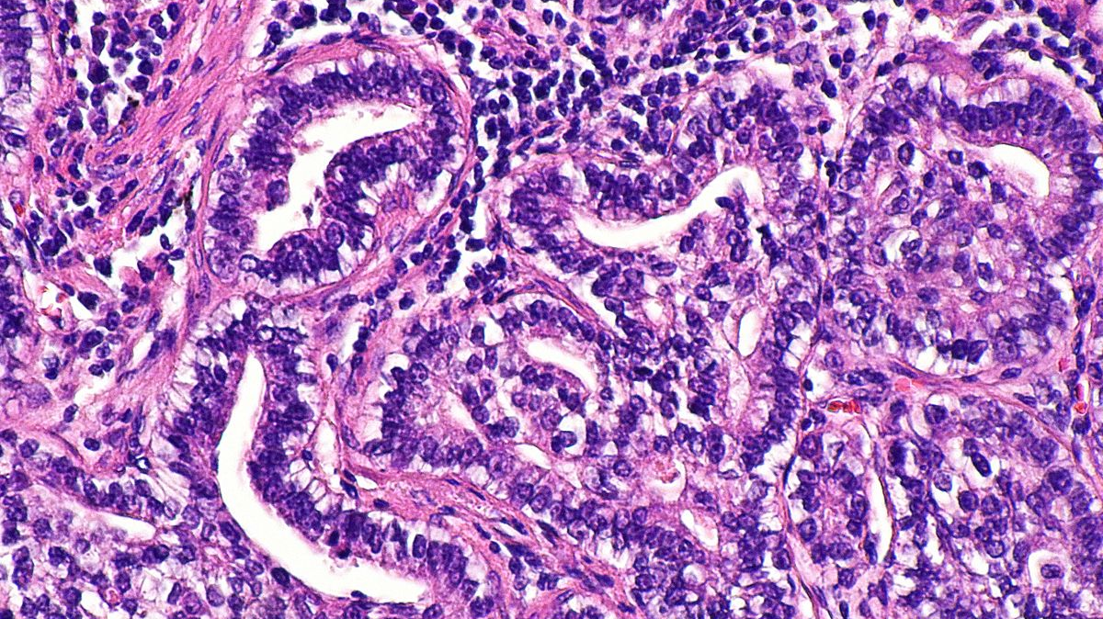
Novel Heteromorphous Convolutional Neural Network for Automated Assessment of Tumors in Colon and Lung Histopathology Images
Authors: Saeed Iqbal, Adnan N. Qureshi, Musaed Alhussein, Khursheed Aurangzeb, Seifedine Kadry
Published: ORCID
Link: https://www.mdpi.com/2313-7673/8/4/370
Research Question(s) / Goal:
The study investigates how a novel heteromorphous convolutional neural network (CNN) can improve the automated detection and assessment of tumors in colon and lung histopathology images. The goal is to create an accurate and efficient model for assessing tumor malignancy with minimal human intervention.
Dataset:
The dataset consists of histopathology images of colon and lung tissues. These images are classified into categories representing malignant and non-malignant tumors and are used to train and test the novel CNN model.
Methodology:
1. Heteromorphous CNN Architecture: The authors introduce a heteromorphous CNN with variable convolutional kernels designed to capture diverse features in histopathology images.(ColonNet)
2. Training: The model is trained on the labeled dataset of lung and colon tissue samples.
3. Evaluation: The performance of the CNN is measured using metrics such as accuracy, precision, recall, and F1-score to assess its ability to detect tumors.
Results & Limitations:
The novel heteromorphous CNN achieved high accuracy(0.95) in detecting and classifying tumors in both colon and lung histopathology images. The heteromorphous structure allowed for better adaptability to different tumor shapes and textures, improving detection performance compared to traditional CNN models.
1. Model Complexity: The heteromorphous CNN has a more complex architecture, requiring significant computational resources for training and deployment.
2. Dataset Limitation: The dataset may lack diverse tumor samples, limiting the model's generalization to different types of tumors or histopathology images.

Slide 6
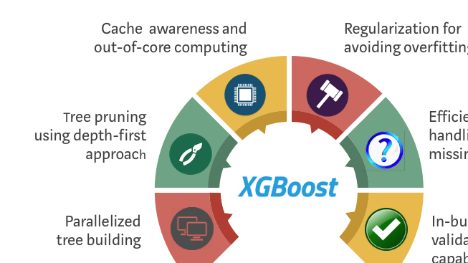
Lung and Colon Cancer Classification Using Medical Imaging: A Feature Engineering Approach
Authors: Aya Hage Chehade, Nassib Abdallah, Jean-Marie Marion, Mohamad Oueidat, Pierre Chauvet
Publication: Journal of Medical Imaging and Health Informatics, 2022
Link: https://pubmed.ncbi.nlm.nih.gov/35670909/
Research question(s) / Goal:
Explore different feature engineering techniques for classifying lung and colon cancer in the LC25000 dataset.
Dataset:
LC25000 dataset
Methodology:
Feature extraction using color histograms, texture features, and deep learning features.
Classification using machine learning models (XGBoost , SVM, Random Forest, Decision Tree, Naive Bayes, K-Nearest Neighbors, etc).
Results & Limitations:
XGBoost performed best with 99% accuracy and F1- score of 98.8%.
Limitations include the potential for overfitting and the need for more complex models for challenging cases.

Slide 7
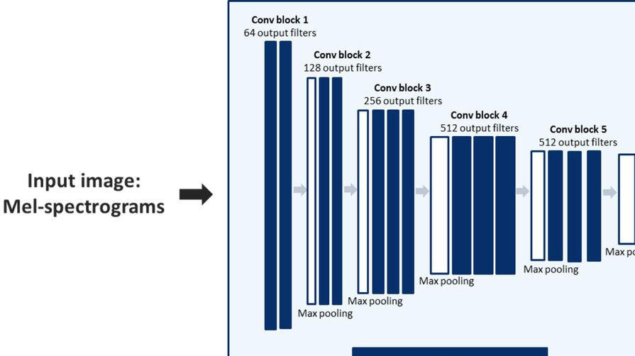
A Modified Convolutional Neural Network Framework for Categorizing Lung Cell Histopathological Image Based on Residual Network
Authors: Sandeep Wadekar, Dileep Kumar Singh
Link: https://www.sciencedirect.com/science/article/pii/S2772442523000916?via%3Dihub
Research question(s) / Goal:
Develop a modified CNN framework for classifying lung cancer biopsy images using pre-trained VGG19 and improved augmentation techniques.
Dataset:
LC25000.
Methodology:
Pre-trained VGG19 model is used as the backbone of the CNN architecture.
Modifications to the VGG19 architecture, such as adding attention mechanisms, feature fusion, or changing the number of layers, could be explored.
Improved augmentation techniques are applied to increase the diversity of the training data.
The model is trained on the dataset and evaluated using appropriate metrics (e.g., accuracy, precision, recall, F1-score).
Results & Limitations:
Achieves up to 97.73% accuracy in classifying lung cancer biopsy images.
Demonstrates the effectiveness of the modified CNN framework and improved augmentation techniques.
Limitations could include the need for larger datasets, potential biases in the dataset, and the complexity of histopathological image analysis.

Slide 8
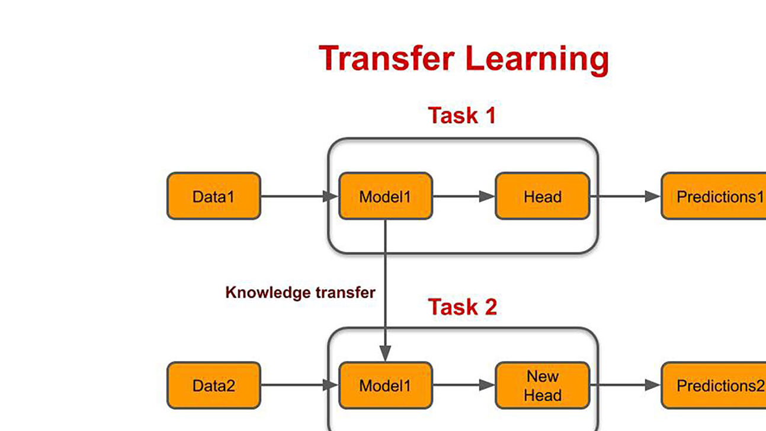
Transfer Learning Approach and Nucleus Segmentation with MedCLNet Colon Cancer Database
Authors: Hatice Catal Reis, Veysel Turk
Link: https://link.springer.com/article/10.1007/s10278-022-00701-z
Research question(s) / Goal:
Develop a transfer learning approach for nucleus segmentation in colon cancer histopathology images using the MedCLNet database.
Evaluate the performance of different deep learning models for classification using the colorectal histology MNIST dataset.
Dataset:
MedCLNet database: a combination of the NCT-CRC-HE-100K dataset, LC25000 dataset, and GlaS dataset.
Colorectal histology MNIST dataset for nucleus detection.
Methodology:
Nucleus segmentation using graph theory, PSO, watershed, and random walker algorithms.
Transfer learning with pre-trained deep neural networks (DenseNet201, DenseNet169, InceptionResNetV2, InceptionV3, ResNet152V2, ResNet101V2, and Xception).
Classification using colorectal histology MNIST dataset.
Performance evaluation using accuracy and other metrics.
Results & Limitations:
Achieved 94.29% accuracy with DenseNet169 model before transfer learning and 95.00% accuracy after transfer learning.
Demonstrated the effectiveness of the proposed transfer learning approach for nucleus segmentation and classification.
Limitations could include the need for larger datasets, potential biases in the dataset, and the complexity of histopathological image analysis.

Slide 9
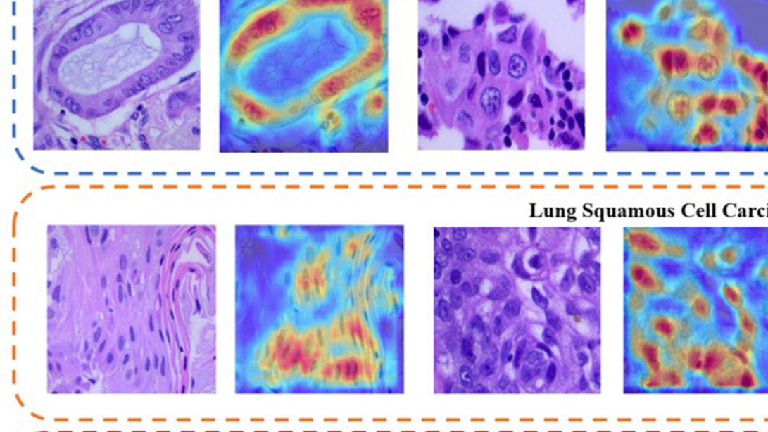
Lung Cancer Lesion Detection in Histopathology Images Using Graph-Based Sparse PCA Network
Link: https://www.sciencedirect.com/science/article/pii/S1476558623000362
Authors: Sundaresh Ram, Wenfei Tang, Alexander J. Bell, Ravi Pal, Cara Spencer, Alexander Buschhaus, Charles R. Hatt, Marina Pasca diMagliano, Alnawaz Rehemtulla, Jeffrey J. Rodríguez, Stefanie Galban, Craig J. Galban
Research question(s) / Goal:
Develop a computer-aided diagnostic tool for automated detection of cancerous lesions in lung histopathology images stained with H&E.
Improve the efficiency and accuracy of lung cancer lesion detection compared to existing methods.
Dataset:
H&E slides obtained from an inducible K-rasG12D lung cancer mouse model.
Methodology:
Graph-based sparse PCA (GS-PCA) network: a machine learning approach consisting of four steps:
Cascaded graph-based sparse PCA
PCA binary hashing
Block-wise histograms
SVM classification
Evaluation metrics: precision/recall rates, F-beta score, Tanimoto coefficient, and AUC of ROC.
Results & Limitations:
Demonstrates improved detection accuracy compared to existing algorithms.
Efficient and accurate for automated lung cancer lesion detection.
Limitations could include the need for larger datasets, potential biases in the dataset, and the complexity of histopathological image analysis.

Slide 10
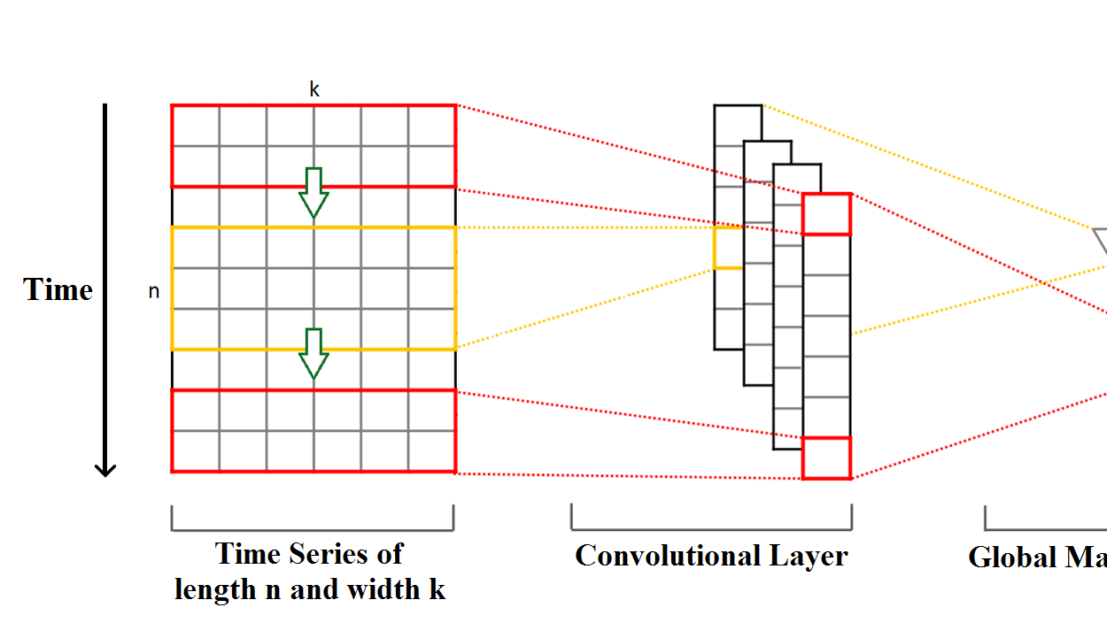
Classification of Non-Small Cell Lung Cancer Using One-Dimensional Convolutional Neural Network
Authors: Dipanjan Moitra, Rakesh Kr. Mandal
Research question(s) / Goal:
Develop a one-dimensional convolutional neural network (1D CNN) for classifying non-small cell lung cancer (NSCLC).
Dataset: They used public dataset of the collection is comprised PET/CT (DICOM) tumor images of 211 patients, semantic annotations of the tumors, segmentation maps of tumors, and quantitative values got from the PET/CT scans.
Methodology:
Utilize a 1D CNN architecture, which is suitable for processing sequential data like time series or spectra.
Apply the 1D CNN to extract features from the NSCLC images or features.
Classify the extracted features into different NSCLC subtypes.
Results & Limitations: (Not mentioned in the prompt, but likely detailed in the full paper)
The paper would likely report the performance of the 1D CNN model in terms of accuracy, precision, recall, F1-score, and other relevant metrics.
Limitations could include the need for larger datasets, potential biases in the dataset, and the complexity of histopathological image analysis.

